Slide 1
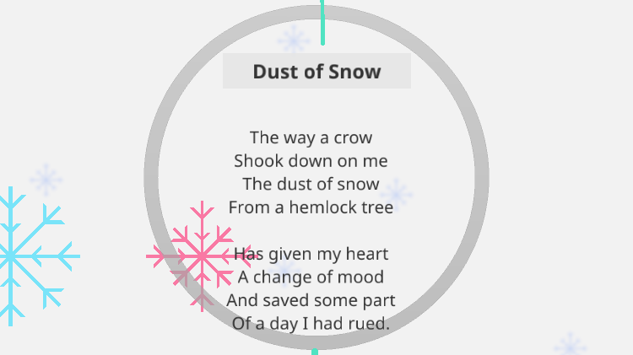

Slide 2
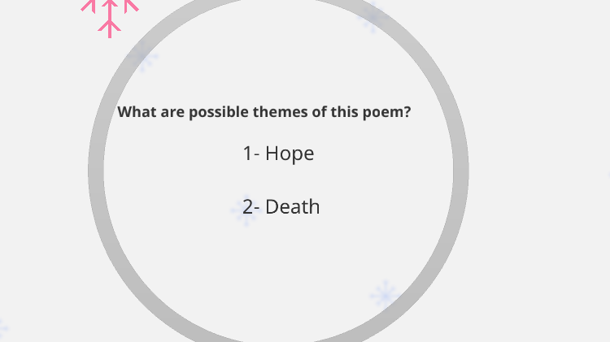
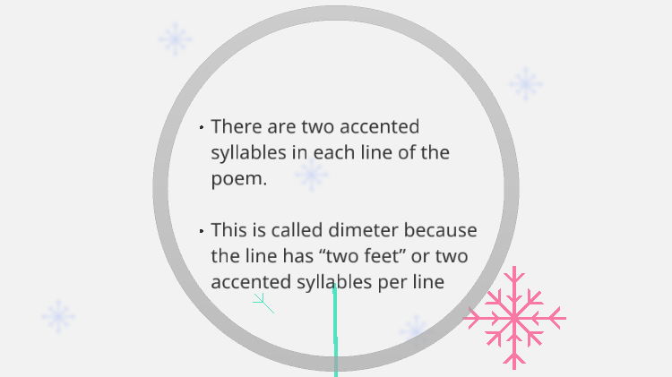
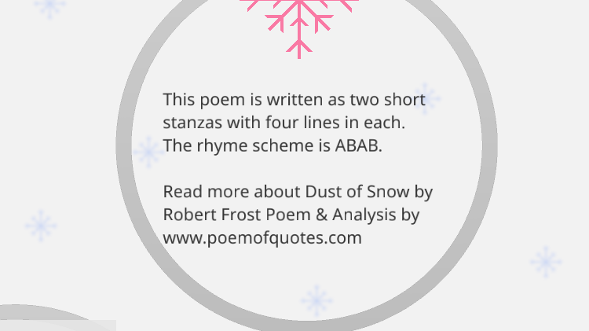

Slide 3
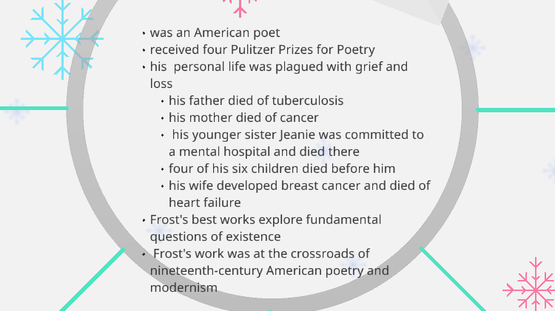
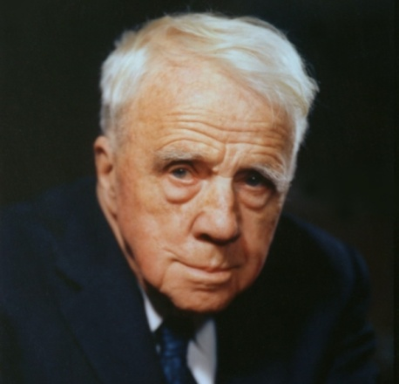
Robert Lee Frost
(March 26, 1874 – January 29, 1963)

Slide 4
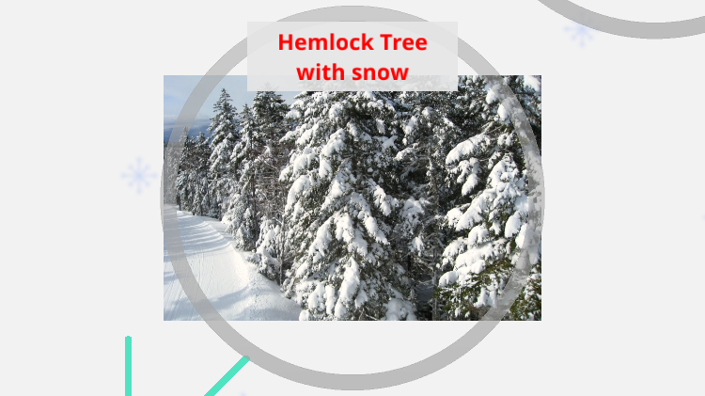

Slide 5
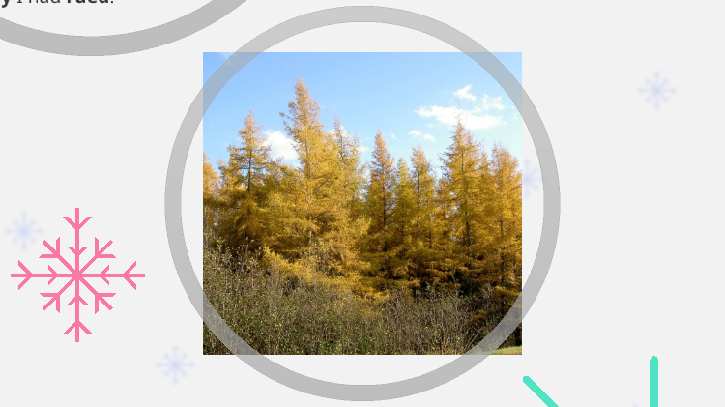
Hemlock Tree without Snow

Slide 6
Summary
The short poem by Robert Frost throws light upon the unimaginable healing power of nature and tiny things.
From a bad mood to ill-health, there is nothing that can’t be cured by nature.
*The author was experiencing one such bad day when a crow’s movement near a hemlock tree dusted snow upon him. The snow instantly makes him happier. His day gets a lot better.
*Thus, the supremacy of nature as a whole made him realise how petty his problem was. The fact that hemlock tree is poisonous combined with crow being the indicator of doom and fear are used in the poem as the carriers of happiness in the life of narrator is ironical.
*The poet, through these objects has tried to highlight that sometimes creatures linked with negative aspects of life can be the bringer of change and happiness. Being outdoors in nature, with all it’s unpredictability can benefit anyone, anywhere at any time.

Slide 7
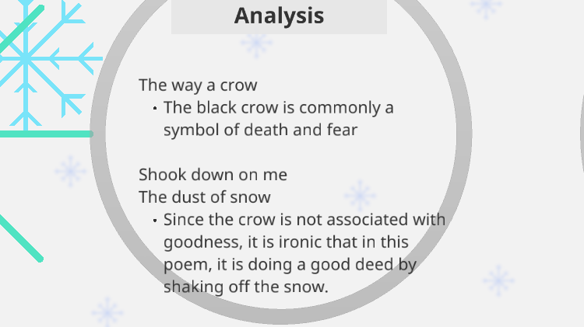

Slide 8
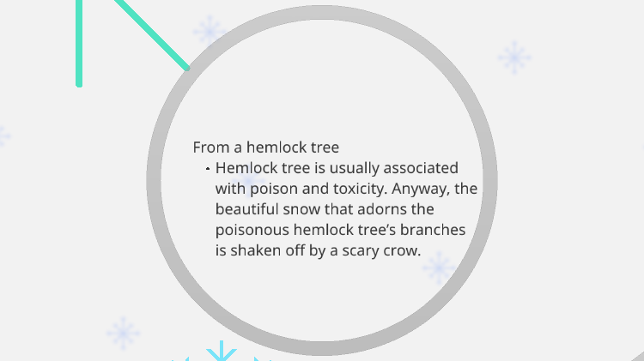

Slide 9
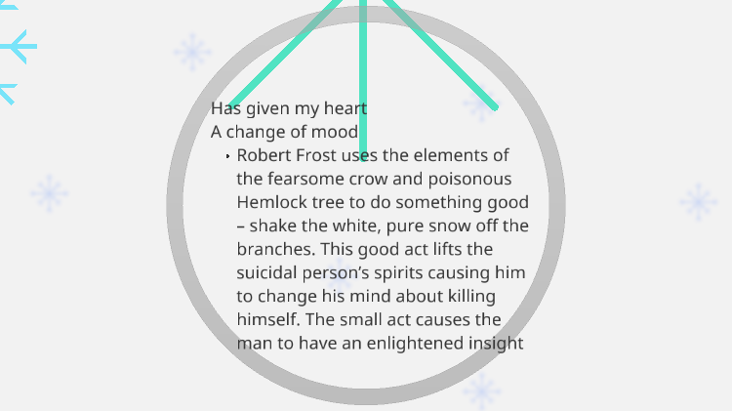

Slide 10
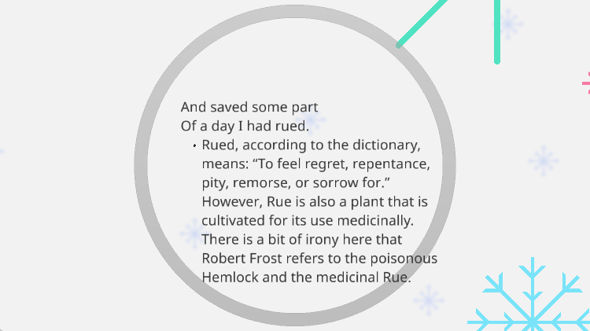

Slide 11
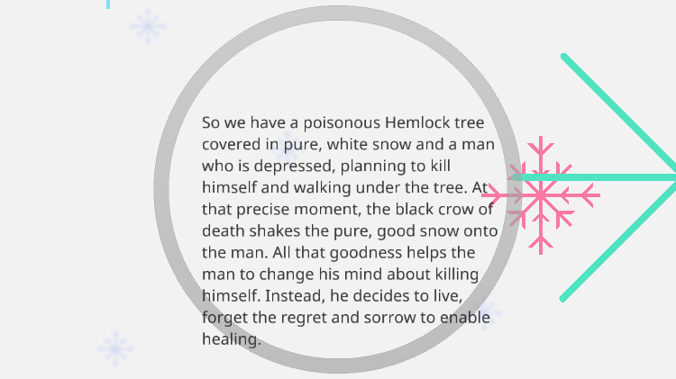

Slide 12
Literary Devices
Rhyme Scheme- abab cdcd
Alliteration- the occurrence of the same letter or sound at the beginning of adjacent or closely connected words.
The instances of alliteration are as follows-
  Has given my heart
  And saved some part
*Inversion - when the structure of a sentence is changed by the poet to create rhyme, this poetic license is called inversion. In stanza 1, inversion can be seen.
*Assonance - the prominence of a vowel sound throughout a line is called assonance. In stanza 1, line 2 - “Shook down on me” - ‘o’ sound is prominent.
*Enjambment - when the same sentence continues to the next line without the use of any punctuation marks, it is called enjambment. It has been used throughout the poem.

